Slide 1
Gas leakage detector using
ARDUINO
STUDENT 1:
2021UIT1089 & VANI J R

Slide 2
Abstract:
GAS LEAKAGE is one of the major problem in the industries and gas powered
vehicle.This Project is about the GAS LEAKAGE SYSTEM USING ARDUINO.Due
to the problem formed by any gas leakage in the area.Device will be
connected to the wireless media connection and maximum and minimum
range will be automated.The gas can be sensed by MQ5 gas sensor. while
monitoring the LPG gas leakage using the device by RGB LIGHT in the
detector.MQ5 GAS SENSOR has the sensitivity and fast response to time.
This experiment system will detect the gas leakage in a minute.

Slide 3
Problem Statement Addressed:
IMPORTANCE OF THE PROJECT:
GAS LEAKAGE DETECTION in the industries and other gas
vehicle machine and other gas oriented areas.Rectification is done by
the experiment.This system will extensively save from environmental
problem by gas leakage like explosion, etc.,

Slide 4
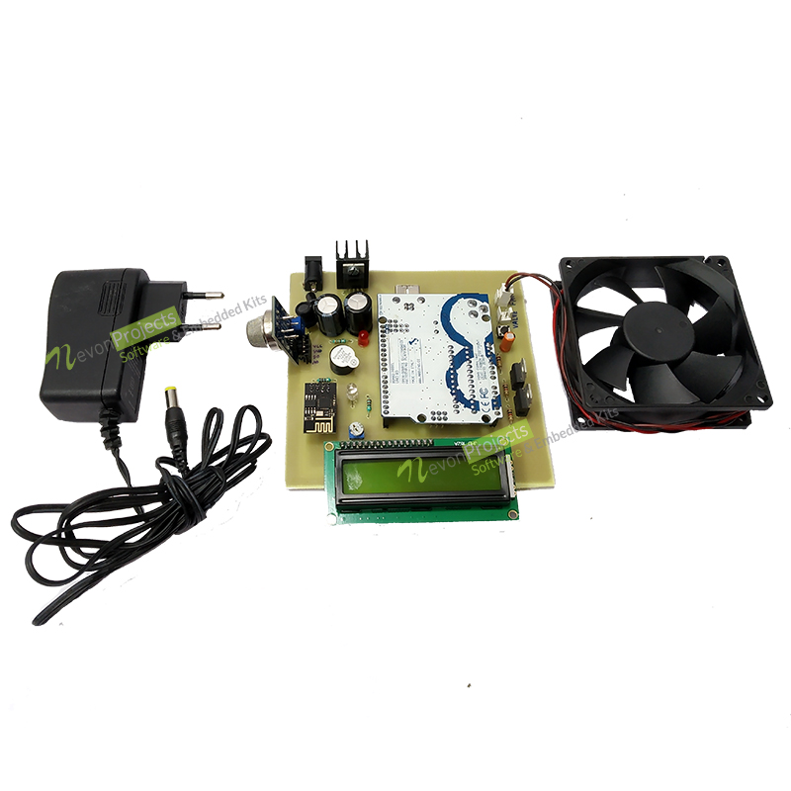
Existing Solution to the Problem Addressed:

Slide 5
Proposed Solution to the Problem Addressed
*Gas leakage detection system, with SMS and sound alert.Has GSM module, buzzer and LED interfaced to Arduino Uno.
*In case of gas leakage, the buzzer starts giving alert, and red LED glows and the gas value is displayed on the LCD, and an SMS is sent to the user for alert.

Slide 6
The sensors are powered by microcontrollers, relays, LCD displays and a buzzer. This voltage regulation sector is responsible for converting alternate power to direct current as well as lowering the transmitted signal. The sensors can detect the gas leak. The sensor MQ-2 is employed here to detect LPG levels in the air. The gasses in the range between 200 and 10000 ppm may be detected as well as the reaction time is quite rapid. The outcome of the sensors would be an analog strength. A serial communication circuit converts the change from analog resistor to voltage. The microcontroller reads that voltage. This analog voltage is digitally converted using a through 12-bit ADC.
In the proposed system of gas detection system, the application contains both the monitoring and detection of the gases which are very harmful for the surrounding. In the detection of the gas, the sensor which is used to sense many gases is MQ 2 sensor. After the detection of leakage in the gas, the sensor sends the signal to the Arduino UNO for the further process where other hardware components are connected to each other. Through Arduino UNO, it send the signal to the LCD display for displaying the alert message as LPG Detected, accordingly, the buzzer be on so that the surrounding people will the alerted, as well as the main power supply will be cut off. Using the relay of 5V, the power supply is given to on the Exhaust fan to remove the harmful gas from the surrounding. Even the Owner of the application will receive the message through GSM module.
In the monitoring system, the LPG cylinder is considered where the application is using the load sensor to weigh the cylinder. If the threshold value which is set to 3Kg is greater than the volume of the Cylinder, then the signal is sent to Arduino Uno which then proceeds the signal to the GSM modem which will send the SMS to the agency for booking of the Gas cylinder. It is then stored the status of the booking the web page which will be easier to use.

Slide 7
Project Work Plan :
The sensors are powered by microcontrollers, relays, LCD displays and a buzzer. This voltage regulation sector is responsible for converting alternate power to direct current as well as lowering the transmitted signal. The sensors can detect the gas leak. The sensor MQ-2 is employed here to detect LPG levels in the air. The gasses in the range between 200 and 10000 ppm may be detected as well as the reaction time is quite rapid. The outcome of the sensors would be an analog strength. A serial communication circuit converts the change from analog resistor to voltage. The microcontroller reads that voltage. This analog voltage is digitally converted using a through 12-bit ADC.
In the proposed system of gas detection system, the application contains both the monitoring and detection of the gases which are very harmful for the surrounding. In the detection of the gas, the sensor which is used to sense many gases is MQ 2 sensor. After the detection of leakage in the gas, the sensor sends the signal to the Arduino UNO for the further process where other hardware components are connected to each other. Through Arduino UNO, it send the signal to the LCD display for displaying the alert message as LPG Detected, accordingly, the buzzer be on so that the surrounding people will the alerted, as well as the main power supply will be cut off. Using the relay of 5V, the power supply is given to on the Exhaust fan to remove the harmful gas from the surrounding. Even the Owner of the application will receive the message through GSM module.
In the monitoring system, the LPG cylinder is considered where the application is using the load sensor to weigh the cylinder. If the threshold value which is set to 3Kg is greater than the volume of the Cylinder, then the signal is sent to Arduino Uno which then proceeds the signal to the GSM modem which will send the SMS to the agency for booking of the Gas cylinder. It is then stored the status of the booking the web page which will be easier to use.

Slide 8
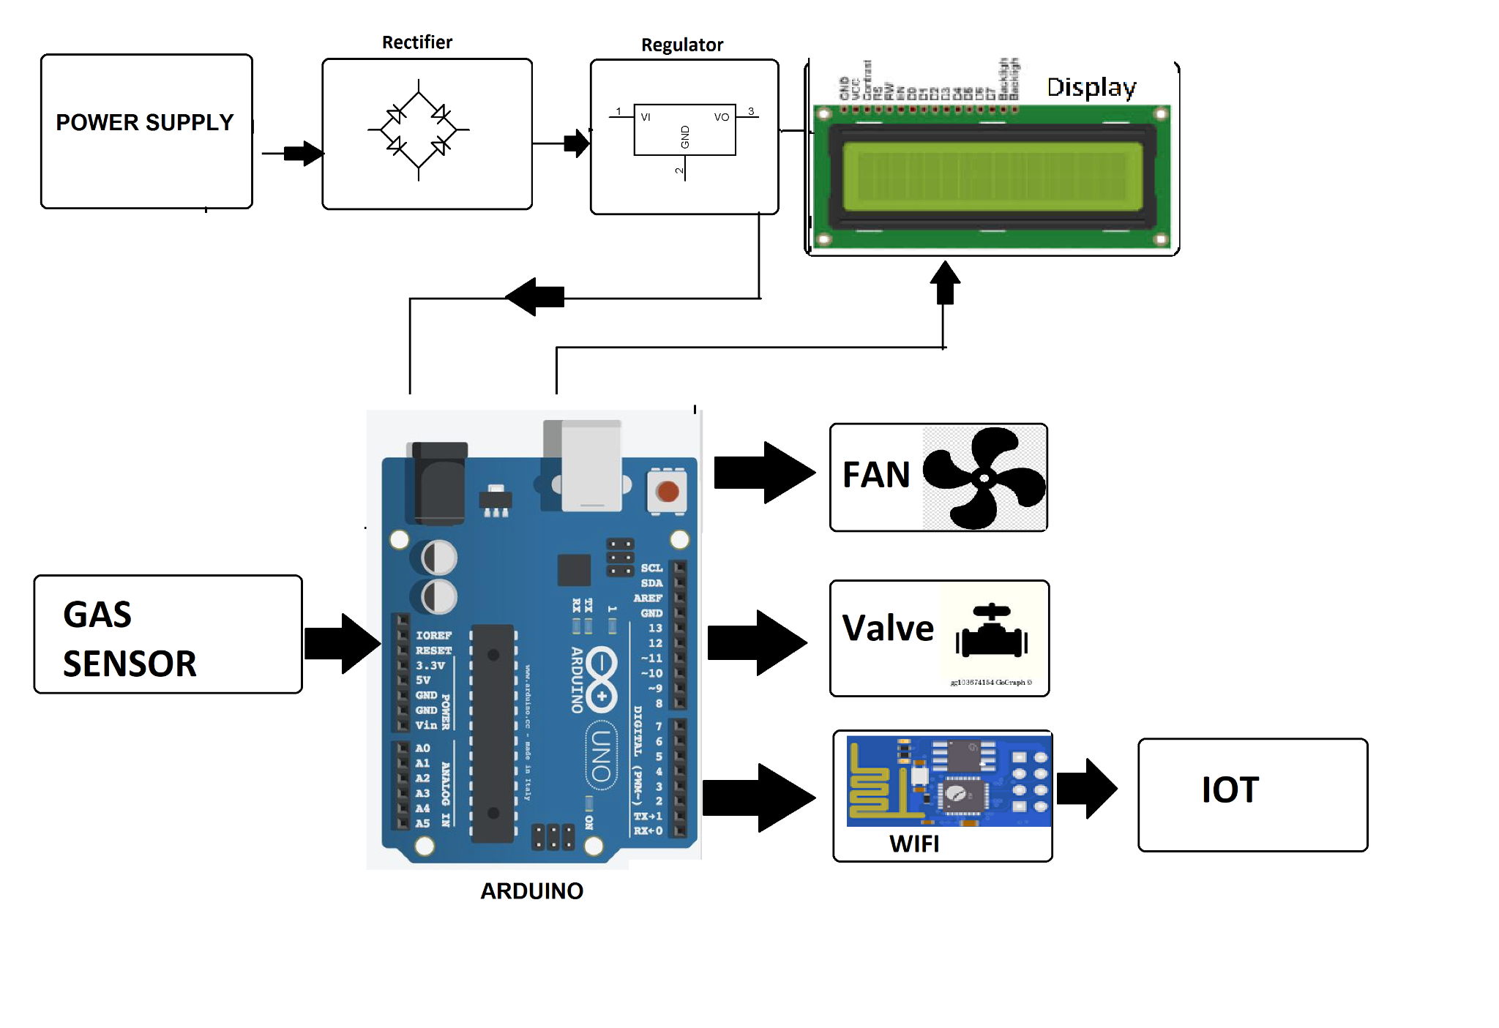
Block Diagram :

Slide 9
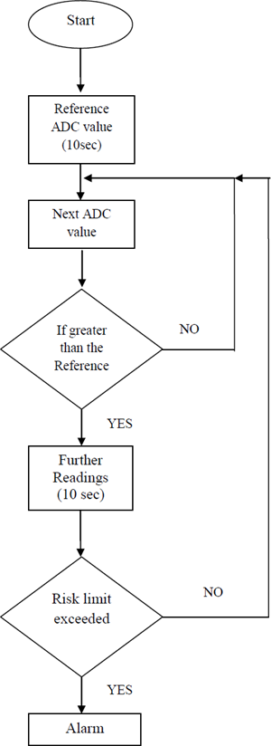
Flow Chart

Slide 10

Effective utilization of the Modern Tool & Cloud
APP:
*https://www.arduino.cc/en/main/software

Slide 11
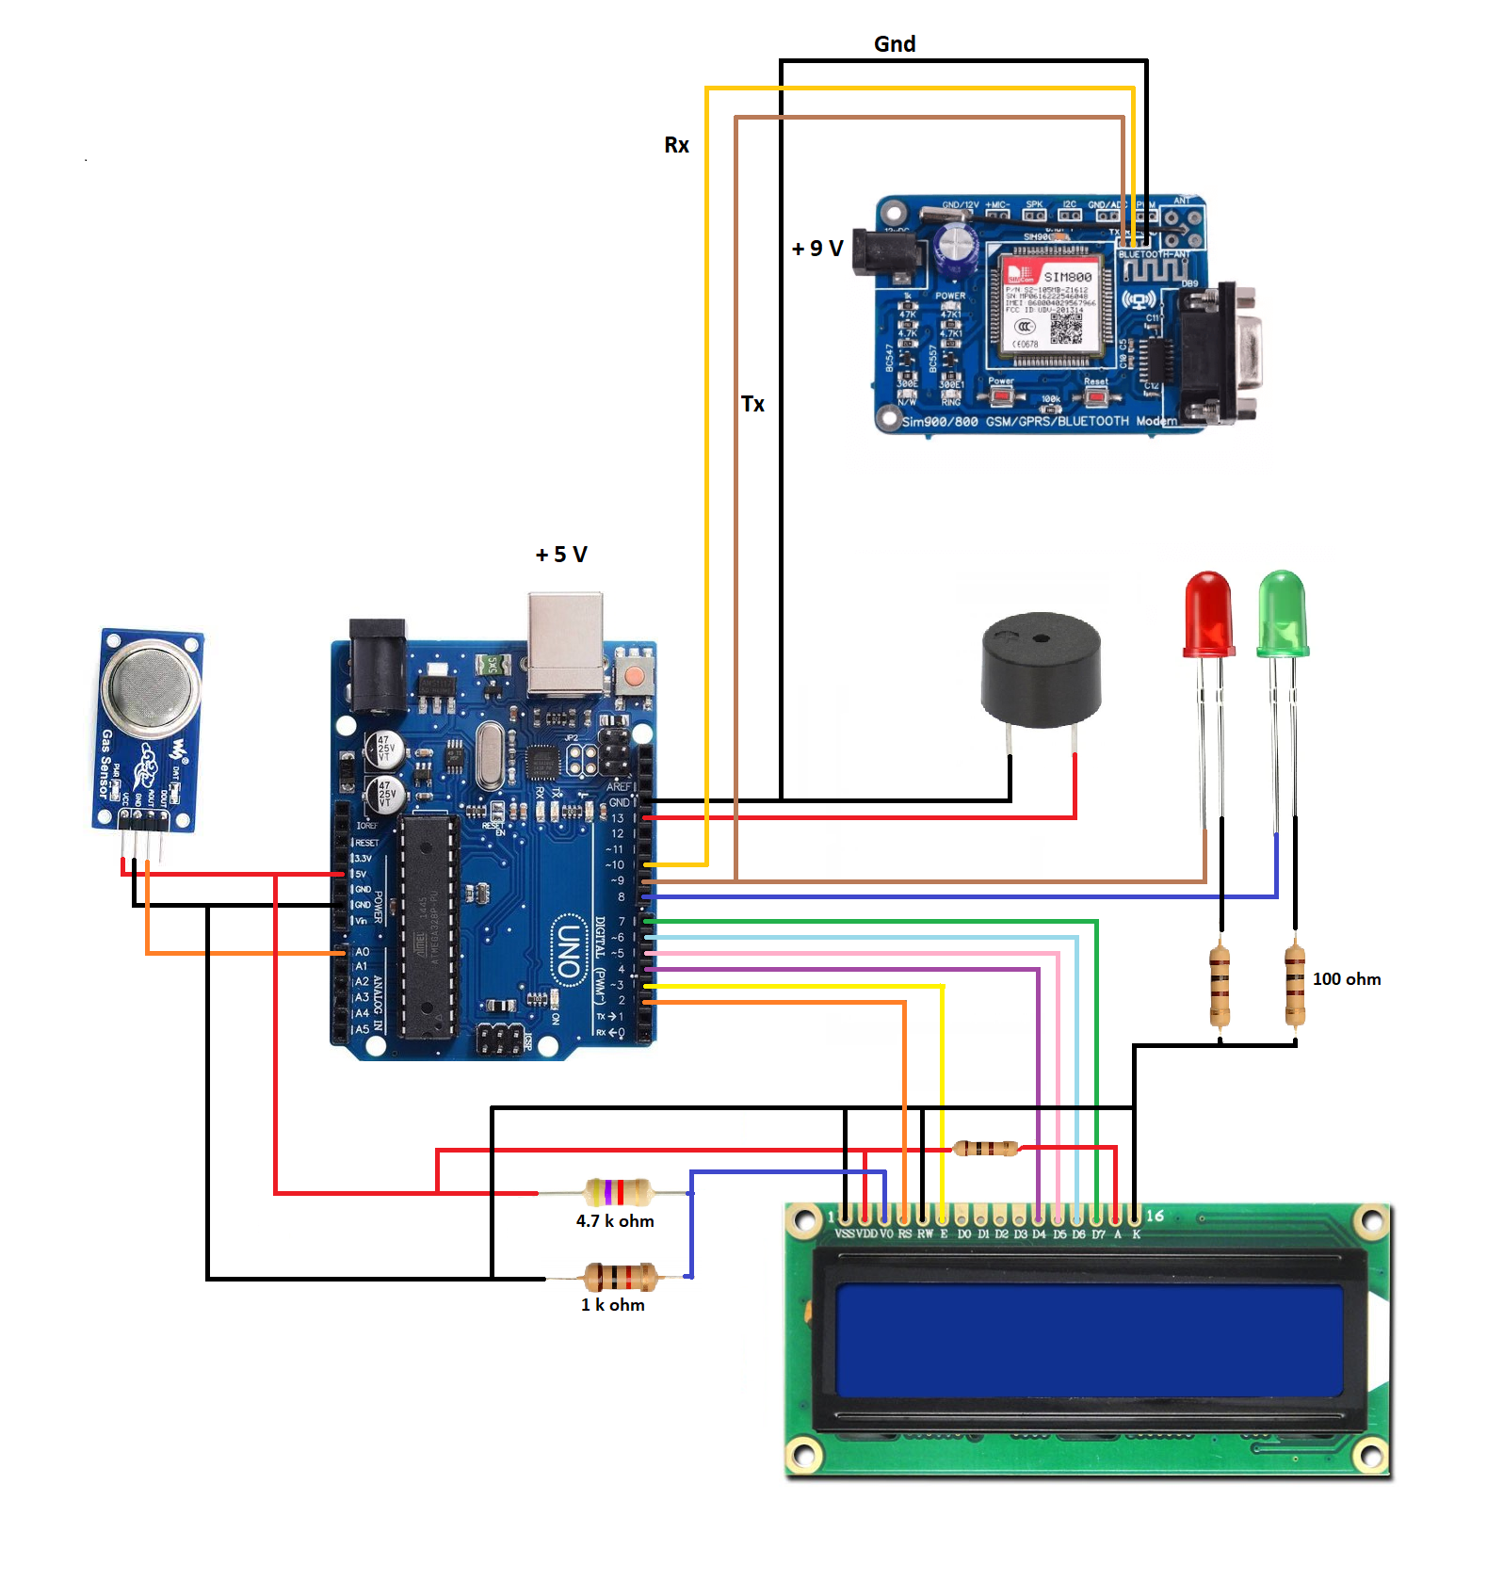
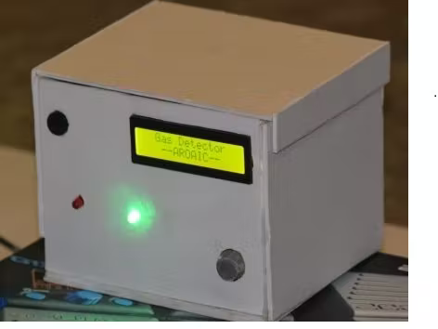
Prototype & Sample Output

Slide 12
Analysis of Results & Discussions :
ADVANTAGES:
*RESOLVE THE ENVIRONMENTAL ISSUES LIKE EXPLOSION ETC.,
*PROBLEM CREATED IN THE GAS VEHICLE AND CHEMICAL
INDUSTRIES.
DISADVANTAGES:
*GAS SENSOR WILL NOT DETECT ALL TYPE OF GASES.

Slide 13
Cost Benefit Analysis (List of Components / Service Used)
S.No | Component Name | Specification (IC number or Range or Value) | Unit Cost | Total Cost
1 | wifi module | Bluecraft ESP-01 ESP8266 Serial WIFI Transceiver Module for Arduino. | Rs.135 | Rs.400
2 | arduino | arduino uno R3 development board | Rs.699 | Rs.699
3 | gas sensor | MQ135 - Air Quality Gas Sensor Module | Rs.112 | Rs.112
4. | buzzer | Active Buzzer Module - 3.3-5V | Rs.33 | Rs.33

Slide 14
Working video Link :
*https://youtu.be/qFxh8TMLl0A

Slide 15
References
*https://ieeexplore.ieee.org/document/7838952
*https://create.arduino.cc/projecthub/395902/gas-leakage-detector-system-bb0877#:~:text=Gas%20leakage%20detection%20system%2C%20with,to%20the%20user%20for%20alert.
*https://www.researchgate.net/publication/319622819_GSM_based_Gas_Leakage_Detection_System
*

